Slide 1

Final Report of Smart Mosquito Trap: Detection Team
Heather Melville
Abdulrahman Almutairi
Saud Aljouhar
Chongxiang Cui

Slide 2
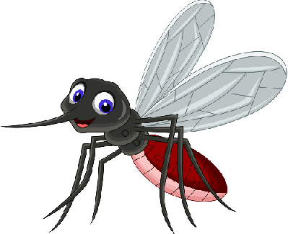
Introduction
Smart Mosquito Trap - Detection Team
Responsible for detecting and notifying the lab of the traps’ activities to prolong the traps’ life cycle without human interference.
Client: Dr. Crystal Hepp of the Bioinformatics Department at NAU
Dr. Hepp published an article of her research of the West Nile Virus in Maricopa County.
From her research, it was identified that the first case of WNV was in 1999 and the virus was established by 2004 in the US.
Abdulrahman

Slide 3
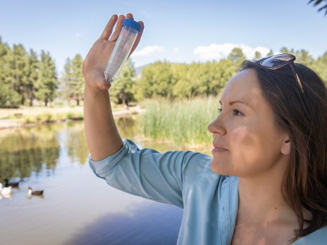
Project Motivation
The WNV, carried by mosquitoes, is a major concern in remote areas across the world and now in Arizona.
Dr. Hepp and her research team want to catch and analyze mosquitoes, to survey the location of the virus in Maricopa County.
This project is made to help the lab to do high scale surveillance in remote areas all over the world.
The results will increase efficiency in finding vital hotspots of the virus to implement protective measures against it.
Abdulrahman

Slide 4
Project Approach
Main: Attract, trap and sense Mosquitoes and transmit that data from remote locations to Dr. Hepp’s lab.
The trap will notify the research lab when a Mosquito has been trapped and detected.
Find and purchase inexpensive and scalable parts to assemble the circuit used to detect the mosquitoes and transmit the detection signal.
Abdulrahman

Slide 5
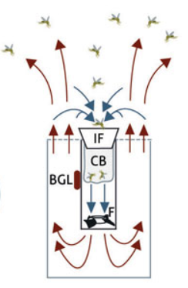
Cont. Project Approach
The circuit must be able to run off of a 12V Battery connected to a Solar Panel provided by the power team.
The detection signal must be transmitted to either the associated lab close to the location of the trap or to Dr. Hepp’s lab located on the NAU campus in Flagstaff, AZ.
The trap must be sustainable for up to 7 days without human interaction; ideally longer than 7 days.
Heather

Slide 6
Prototypes
Ultrasonic Sensor HC-SR04: Inaccurate measurements and unstable readings.
PIR HC-SR501: Mosquitoes are cold blooded insects and their infrared rays are similar to other insects, so the sensor won’t work.
RF (433 Mhz) transmitter: Due to range limits, it won’t be functional for our trap.
Abdulrahman

Slide 7
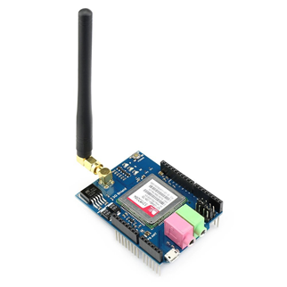
Cont. Prototypes
●3G cellular Shield for Arduino (American Version).
●It can use 3G/GSM cell phone network to send or receive data from remote locations.
●The module can send our data via text messages to the client using a compatible and unlocked SIM card.
Abdulrahman

Slide 8
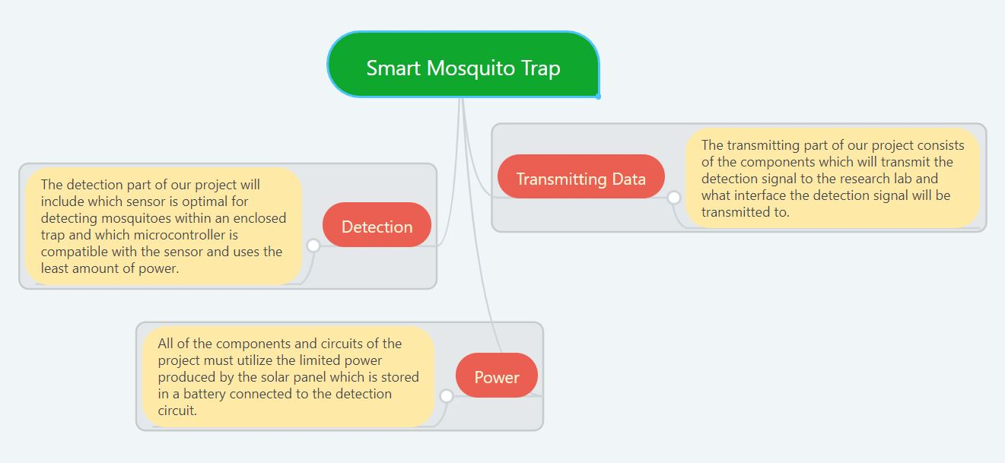
Subsystems
Detection of the mosquitoes
Transmission of the detection signal
Power consumption from the LoRa transmitter and the detection circuit
Heather

Slide 9
Subsystems Breakdown
Detection of the mosquito within the trap using a sensor:
Detection with InfraRed Sensor - Chongxiang
Detection with Ultrasonic Sensor - Chongxiang
Detection with Sound Sensor - Heather
Detection with Microphone Amplifier - Heather
Transmission of detection signal of mosquito to the research lab:
Transmission with WIFI module - Abdulrahman
Transmission with LoRa transceiver - Saud & Chongxiang
Power consumption awareness and limitations - all team members
Saud/Heather

Slide 10
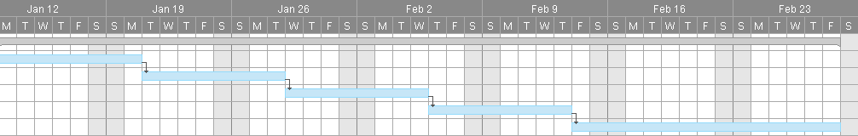
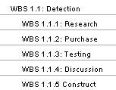
Detection
Responsibility: To create a circuit that detects the mosquitoes efficiently.
Concerns: Other bugs are also attracted to CO2 and may be caught in the trap as well, need a way to differentiate between other bugs and mosquitoes.
Circuit must not consume a lot of power.
Timeline: Based on our Gantt Chart from the previous semester the detection circuit would be finalized, constructed and ready for incorporation with the transmission part of the circuit and the power team by February 23rd.
  That deadline was not met due to failed prototypes and quarantine circumstances
Heather

Slide 11
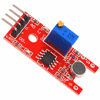
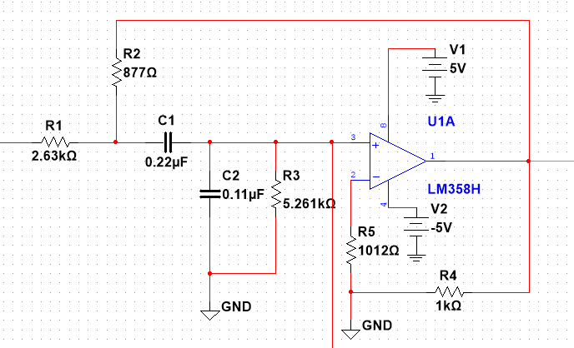
Detection: Sound Sensor
Decided to create a circuit that would detect and differentiate a mosquito within the trap from other bugs that entered.
First prototyped with the KY 038 sound sensor
Sallen-Key bandpass filter
Adjusted the potentiometer so that the LEDs of the sensor would lite up when any sound detected.
LED lit up when snapping near microphone but did not using sound clips or frequency test tones.
Sensor not fit for our project so conducted more research of a different sensor
Heather

Slide 12
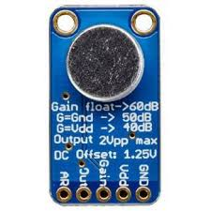
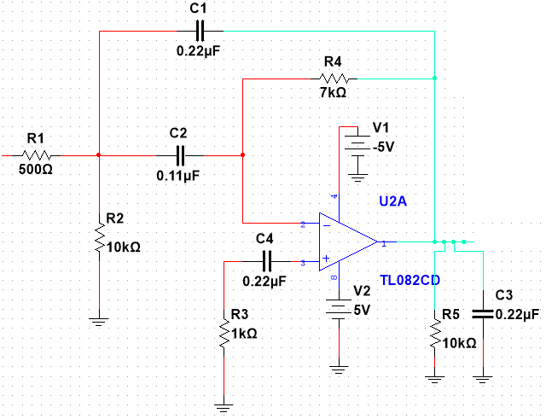
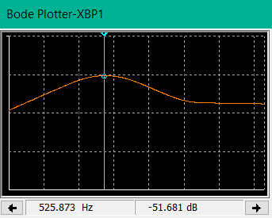
Detection: Microphone Amplifier
First Stage:
Purchased MAX9814 Microphone Amplifier
Created and simulated using Multisim, a correct bandpass filter to obtain a frequency range between ≅ 400 Hz-800Hz
Heather

Slide 13
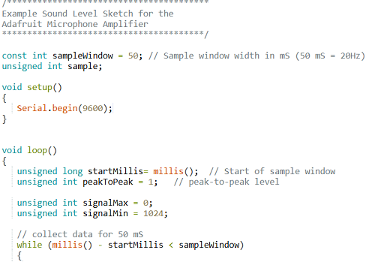
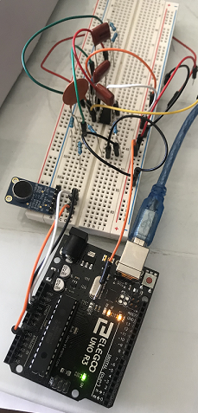
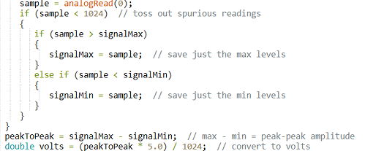
Detection: Microphone Amplifier
Heather
Second Stage:
Construct the circuit
Find/write code to test the Microphone Amplifier
After constructing the circuit realizing that I need a negative voltage supply for the Op Amp in the band pass filter.

Slide 14
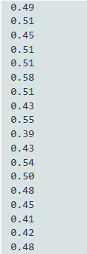




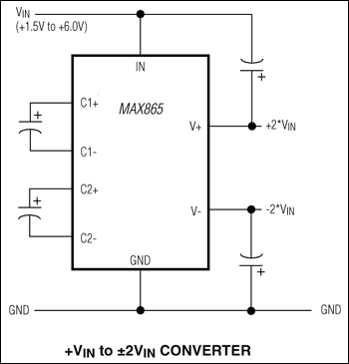
Detection: Microphone Amplifier
Third stage:
Test the Microphone Amplifier by itself
Researched and found charge pump to create negative power supply for Op Amp
Purchased MAX 865 Charge Pump
Voltage Values: No Sound 300Hz 550Hz 800Hz 1000Hz
Heather

Slide 15
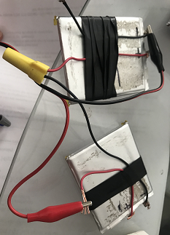
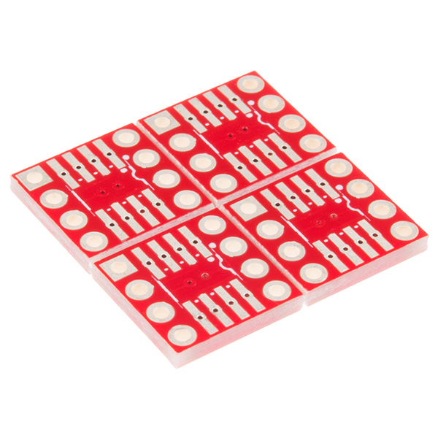
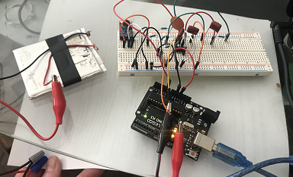
Detection: Microphone Amplifier
Fourth Stage:
MAX865 chip received but too small for breadboard so purchased a surface mount and headers
Surface mount wrong size but tried to solder anyway and was unsuccessful
Created negative voltage from batteries in series to test filter
Heather

Slide 16

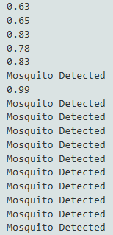
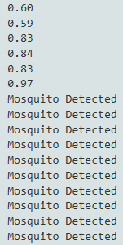
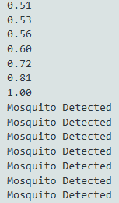

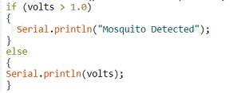
Detection: Microphone Amplifier
Fifth Stage:
Test circuit with filter using batteries for negative voltage
Adjust the code to print message “Mosquito Detected”
Filter and Microphone Amplifier work!!
Voltage Values:
No Sound 400Hz 550Hz 800Hz 1000Hz
Heather

Slide 17
Transmission: LoRa transceiver
LoRa transceivers with long range modem provide ultra-long range spread spectrum communication and high interference immunity whilst minimizing current consumption.
LoRa also provides significant advantages in both blocking and selectivity over conventional modulation techniques, solving the issues between range, interference immunity and energy consumption.
The Lora 1276 we chose works well with the Arduino, and the receiver can receive signal from the transmitter immediately.
Chongxiang

Slide 18
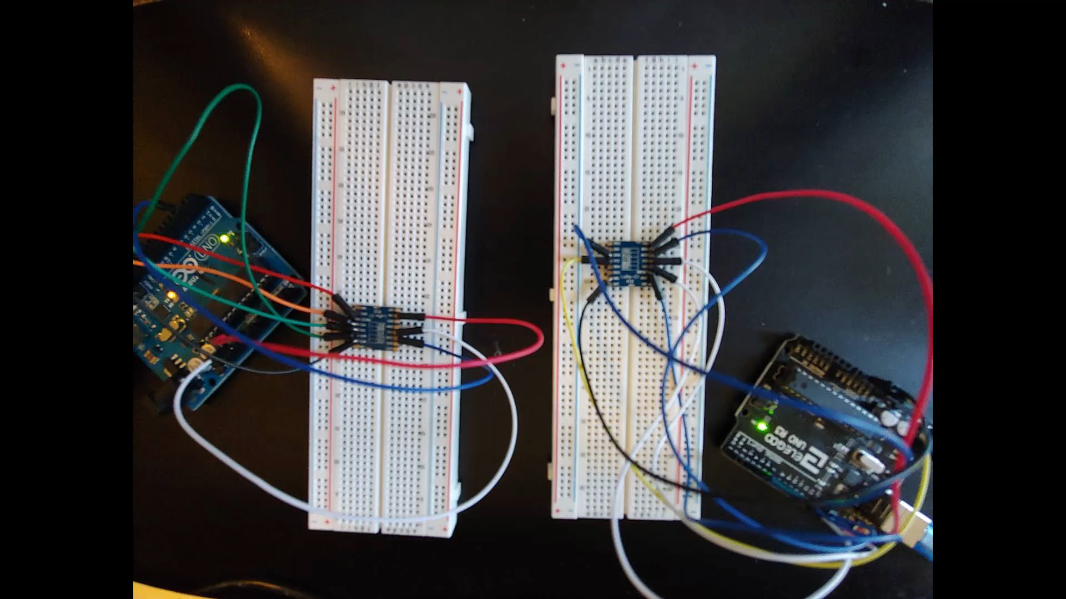
Transmission: Successful LoRa transmission
Chongxiang

Slide 19
Challenges
Chongxiang/Heather/Saud
Transmitting distance & Non Functional Parts
  Normally, Lora transceiver has a working distance of 10 km, which is much less than the distance between location of the trap and Flagstaff, AZ. So we planned to use the LoRa transceiver to transmit the data of the mosquito detection to the nearest laboratory in Maricopa County first, then uploaded the data to a google drive through the WIFI in the laboratory.
  Some of the parts did not work well and had to be replaced in order to achieve efficient results.
Noise interference
  When detecting mosquitoes by the microphone amplifier, other noises might be detected. We implemented the use of a bandpass filter to filter the specific frequency of the mosquitoes the trap will capture.
World Crisis
  In our individual homes we have limited equipment to test or subsystems and are unable to integrate all the parts together and test them with the trap due to social distancing and online environment.

Slide 20
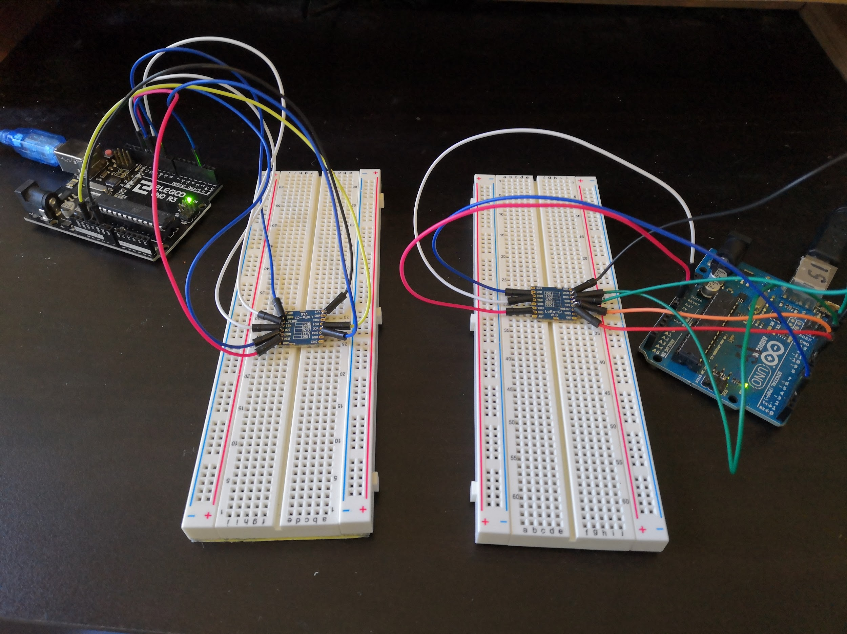
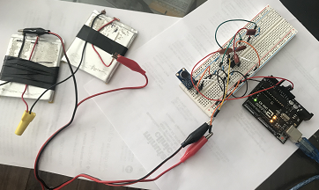
Final Product
Transmission Circuit with LoRa transmitter and receiver
Detection Circuit with Microphone Amplifier
Detects mosquitoes with a frequency range of 400Hz-800Hz
Transmits messages from transmitter to receiver located within 10km of each other
Heather

Slide 21
Future Work
Find and purchase charge pump compatible with detection circuit and retest circuit once integrated.
Find and purchase LoRa transceiver that has extended range to meet project requirements
Once transmission circuit with extended range LoRa system have been successfully retested then must be incorporated and retested with detection circuit.
Integration of combined circuit with power system and trap to test full functionality of detection, transmission and power consumption.
Then create PCB of combined circuit to increase efficiency and reduce size for use in the field.
Retest PCB circuit with power system and trap
Heather

Slide 22
Conclusion
Goal of project:
Create a circuit to be incorporated with an existing trap that can attract, and detect mosquitoes.
Transmit the detection signal to Dr. Hepp’s lab located in Flagstaff, AZ.
Power consumption of circuit limited to 12V specified by power team.
Goals met:
Detection circuit that detects sound within the range of 400Hz-800Hz which the mosquitoes’ wing beats falls into.
Transmission of messages using LoRa transceiver and receiver within a 10km range.
Each circuit consumes less than 12V.
Still need to integrate all parts together and test with trap
Saud/Heather

